Slide 1

SEXUAL ASSAULT AWARENESS & HELP SYSTEM
AJINKYA BHABAD
ANKITA DHARURKAR
HARSHIL PATEL

Slide 2
PROBLEM STATEMENT
There is no centralized system that can help sexual assault victims to get their lives back to normal.
There is no system available which stores the sexual assault details and transfer the data to involved entities. Hence Help Seeker needs to re-iterate the scenario multiple times which impacts the mental health of the helpseeker
There is no system available which provides the mental, Legal and health related help on a single platform.

Slide 3
APPROACH
Uplift the victims by connecting them with the Help Providers who previously dealt with the same scenario.
Prevent the mental health impact caused by re-iteration of the scenario by connecting the sexual assault details with all involved entities.
Providing a system that connects Help Seeker with Doctor, Counselor and Lawyer on a single platform to improve efficiency of the whole process.

Slide 4
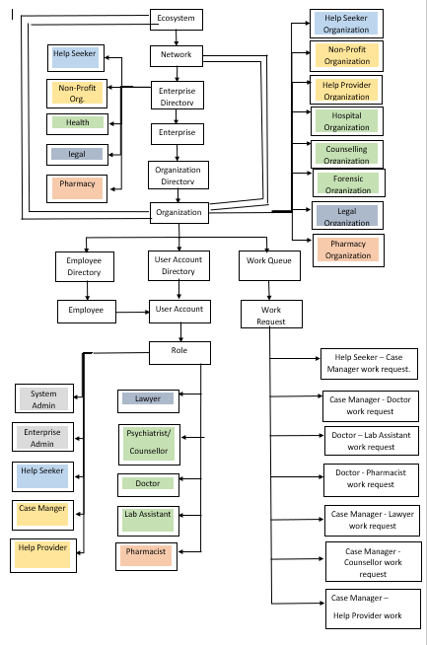
OBJECT MODEL

Slide 5
ENTERPRISES
SYSTEM ADMIN
Manages Network and all the enterprise admins
MANAGE NGO ENTERPRISE
NGO enterprise admin manages employees of the NGO
MANAGE HEALTH ENTERPRISE
Health enterprise admin manages employees of the Hospital
MANAGE LEGAL ENTERPRISE
Legal enterprise admin manages employees of the Lawyers
MANAGE PHARMACY ENTERPRISE
Pharmacy enterprise admin manages employees of the Pharmacy

Slide 6
Use Case 1 HelpSeeker - CaseManager WorkRequest
Help Seeker registers a report with all the details regarding the assault.
The request is sent to the CaseManager who accepts and assigns the case to concerned entities for further proceedings.

Slide 7
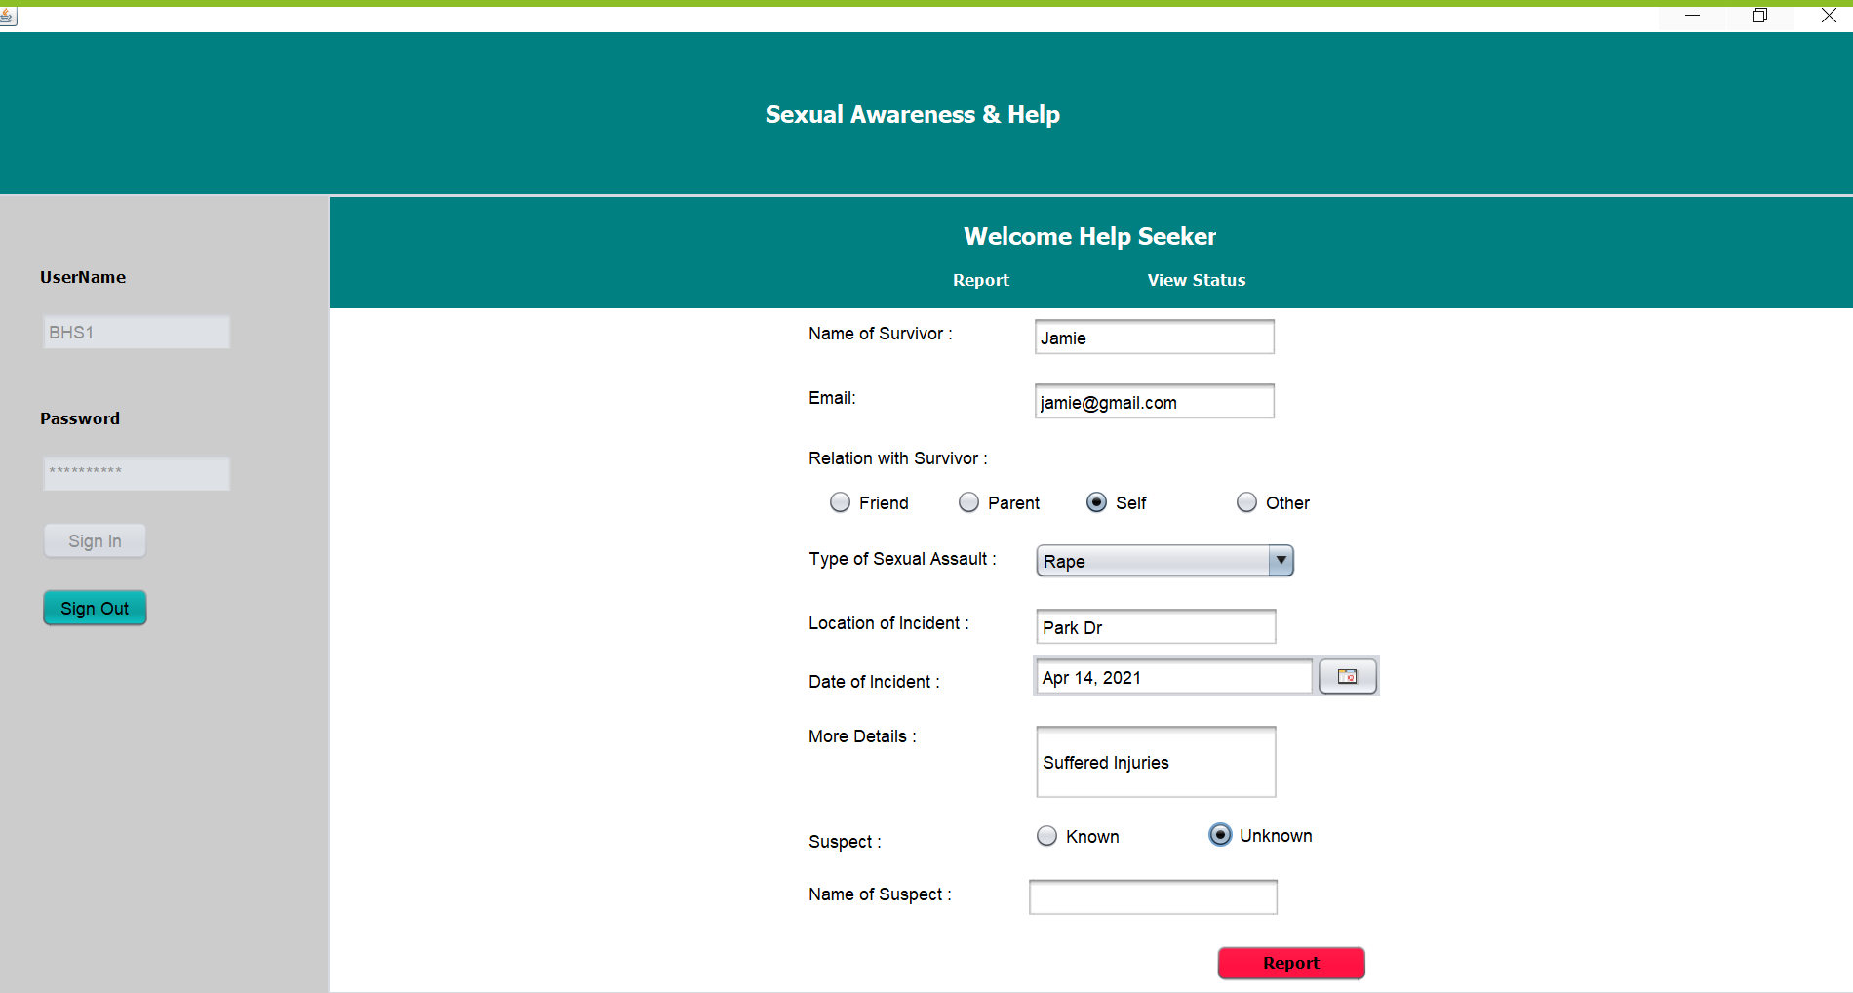
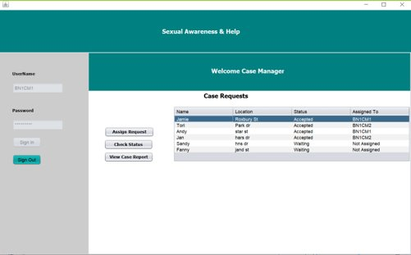

Slide 8
Use Case 2 CaseManager-Doctor WorkRequest
CaseManager reads the report regarding the assault and request is sent to Doctor.
The Doctor accepts a case and sends invite to the patient for appointment.

Slide 9
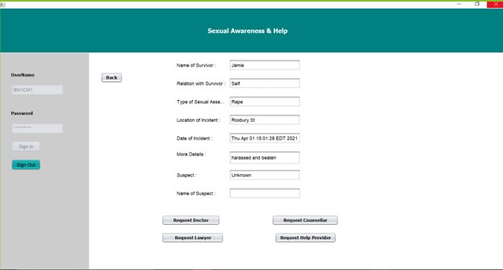
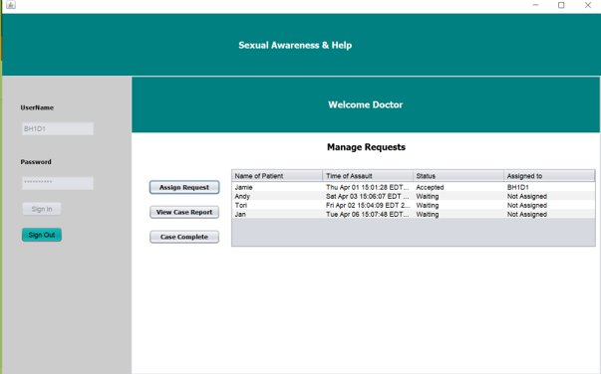

Slide 10
Use Case 3 Doctor-LabAssistant WorkRequest
Doctor reads the report regarding the assault and request is sent to Lab Assistant for conducting the Lab Tests.
The Lab Assistant accepts a lab test requests and sends results to the doctor.
The Doctor can then view the results.

Slide 11
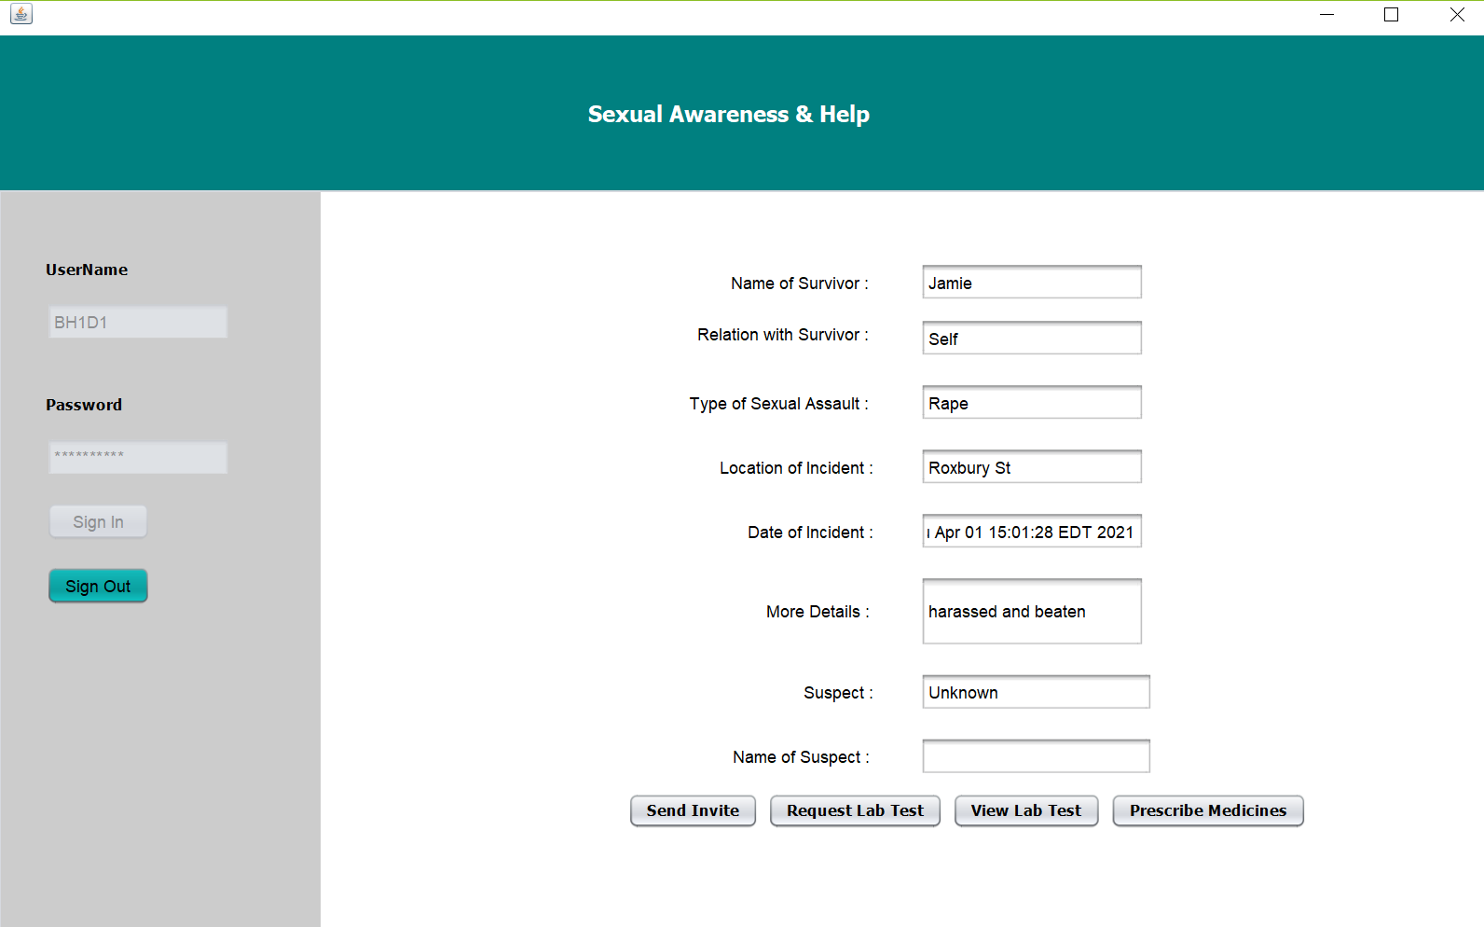
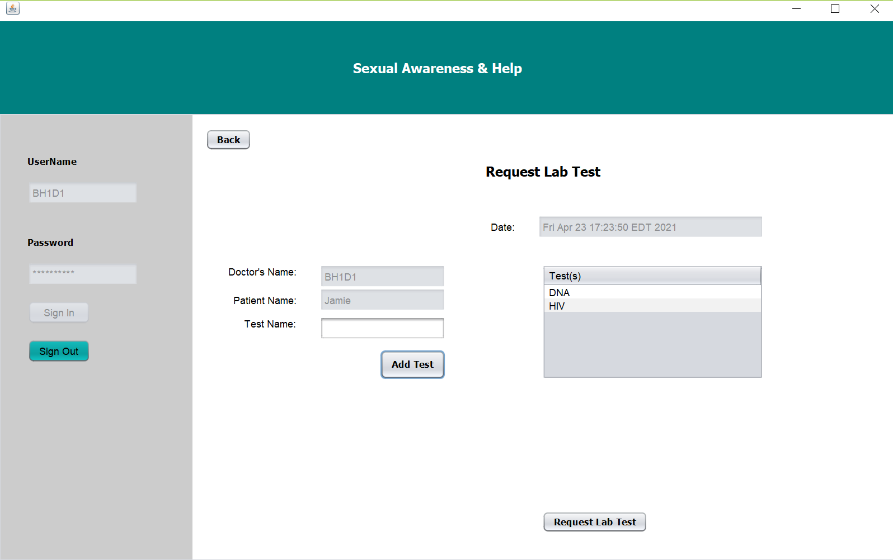

Slide 12
Use Case 4 Doctor - Pharmacy WorkRequest
Doctor sends the request to Pharmacist after the health check-up.
The Pharmacists views the prescription request and sends invite to patient for pickup.

Slide 13
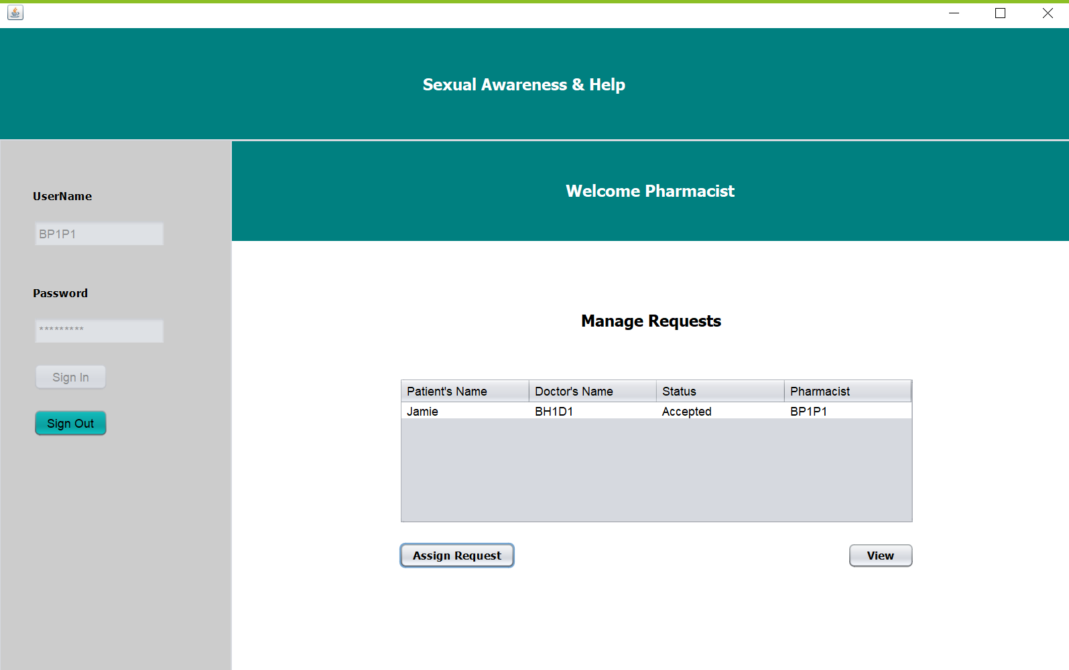
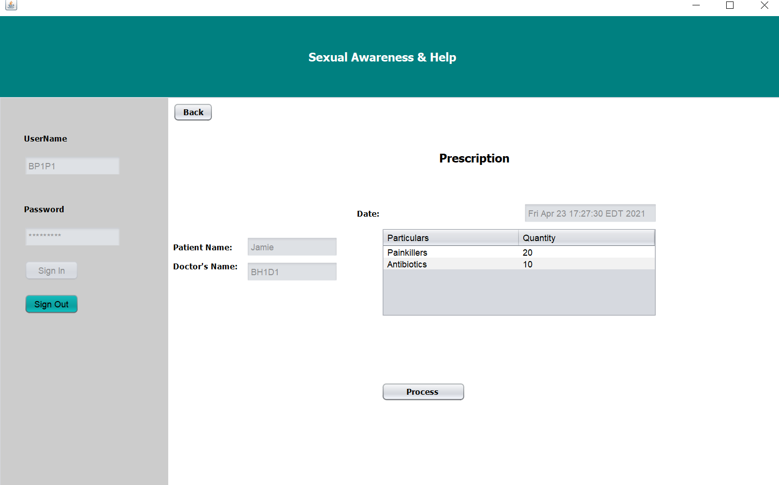

Slide 14
Use Case 5 CaseManager-Counselor WorkRequest
CaseManager reads the report regarding the assault and request is sent to Counselor.
The Counselor accepts a case and sends invite to the patient for appointment.
The counselor keeps a record of each encounter.

Slide 15

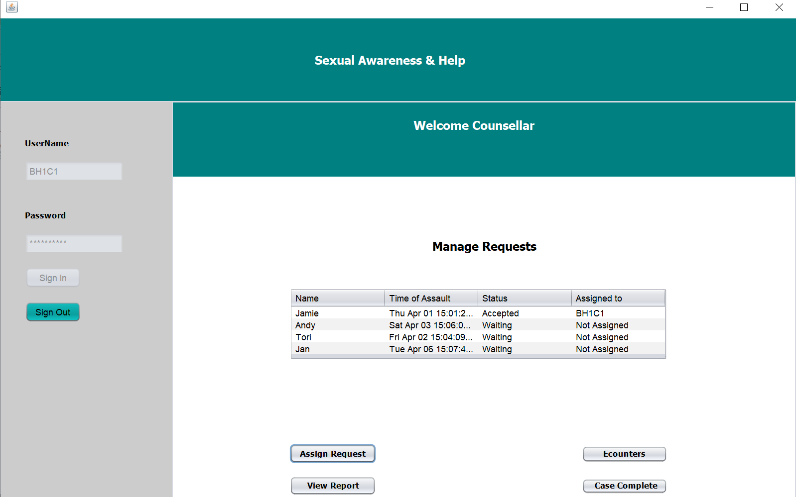

Slide 16
Use Case 6 CaseManager-Lawyer WorkRequest
CaseManager reads the report regarding the assault and request is sent to Lawyer.
The Lawyer accepts a case and sends invite to the patient for appointment.
The Lawyer keeps a record of each encounter.

Slide 17
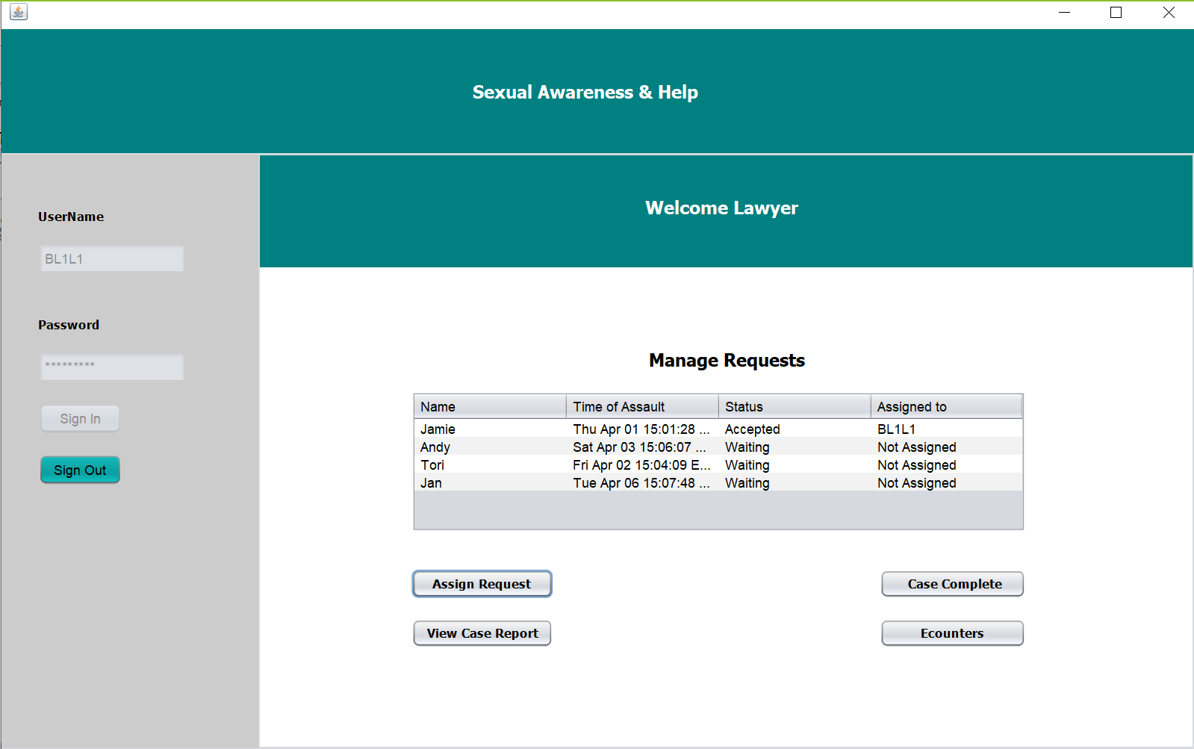

Slide 18
Use Case 7 CaseManager-Help Provider WorkRequest
CaseManager reads the report regarding the assault and request is sent to Help Provider.
The Help Provider accepts a case and sends invite to the patient for appointment.
The Help Provider keeps a track of each encounter and progress.

Slide 19
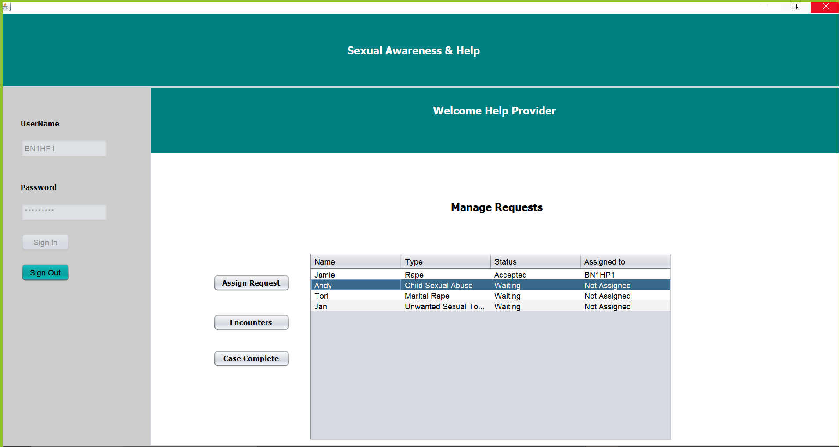

Slide 20
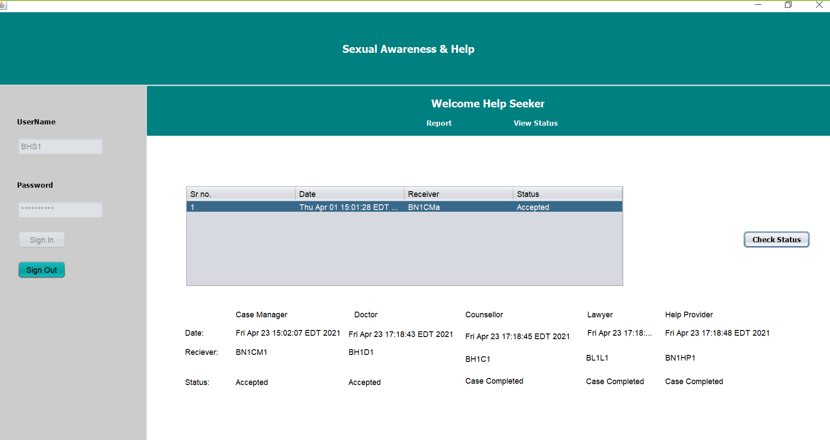
Help Seeker View Status

Slide 21
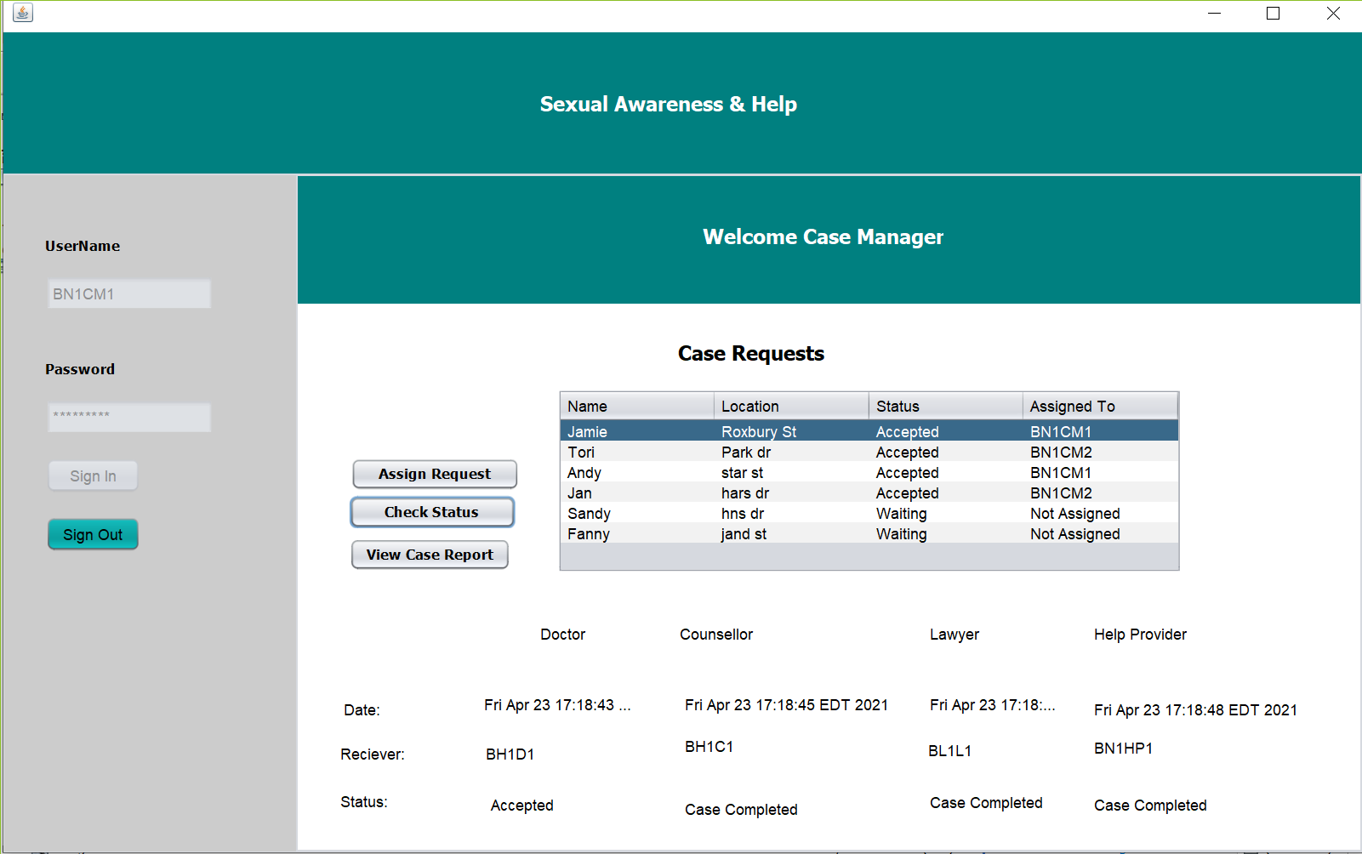
Case Manager View Status

Slide 22
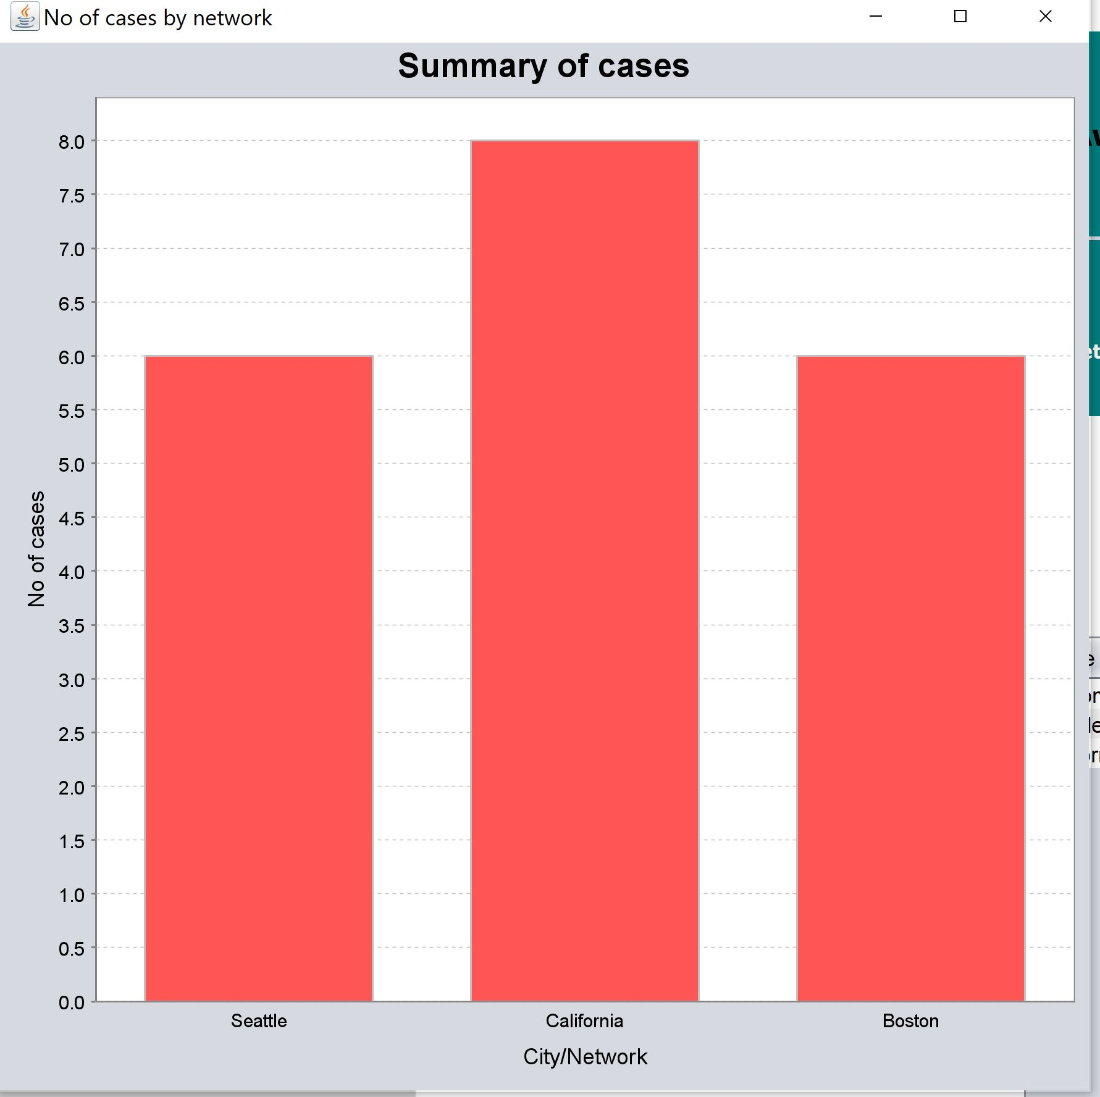
Bar Graph for all networks

Slide 23
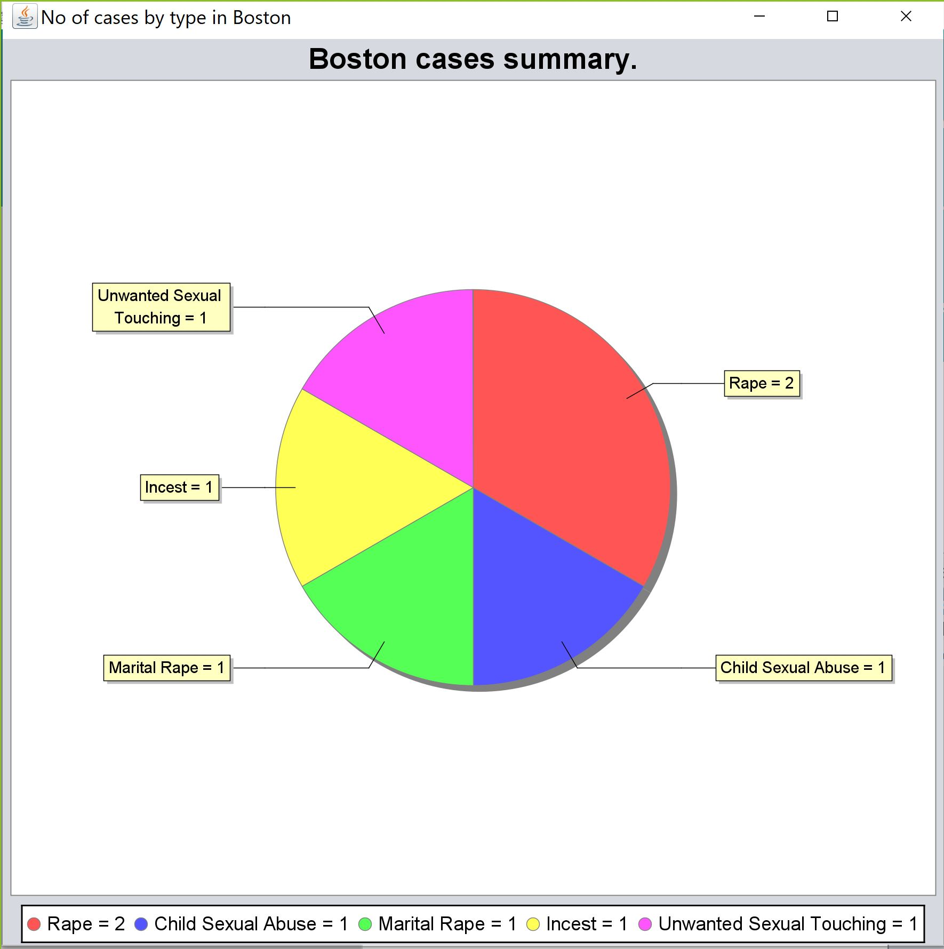
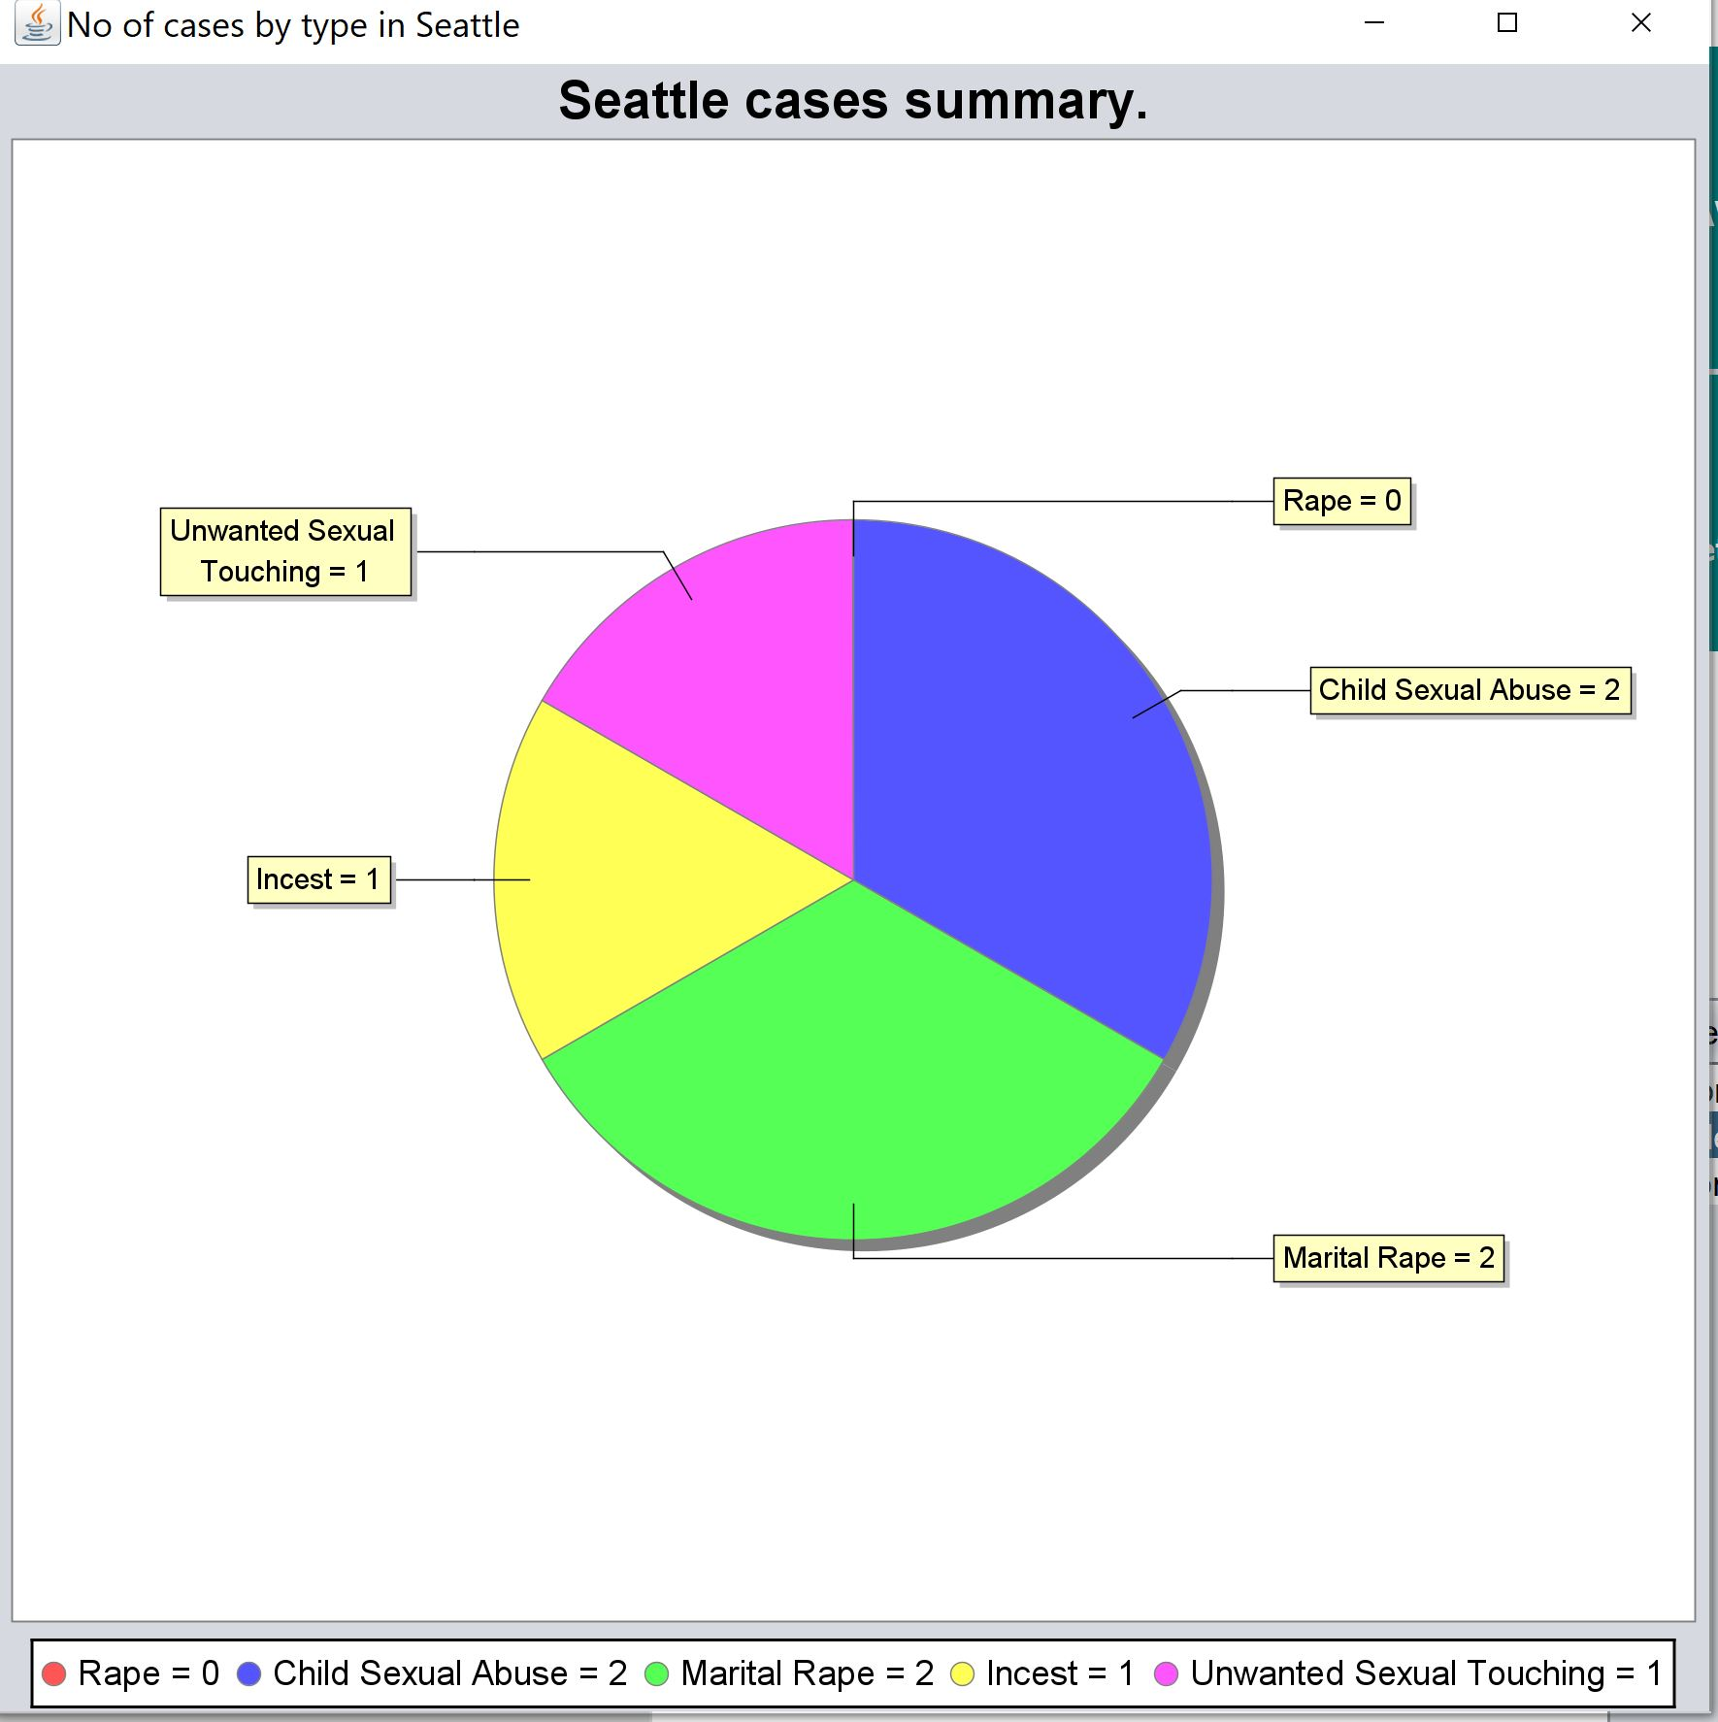
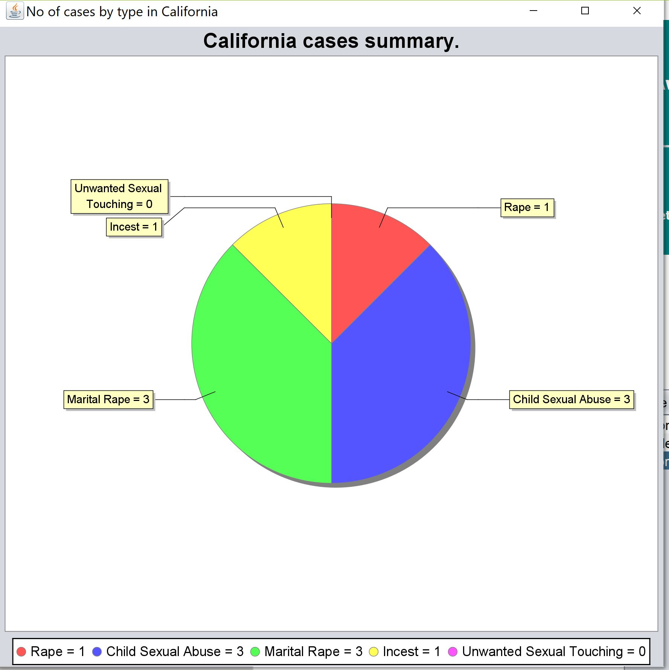
Pie chart for each network

Slide 24
THANK YOU

